Slide 1



What, Where, and When in DHIS2
Introduction to DHIS2

Slide 2


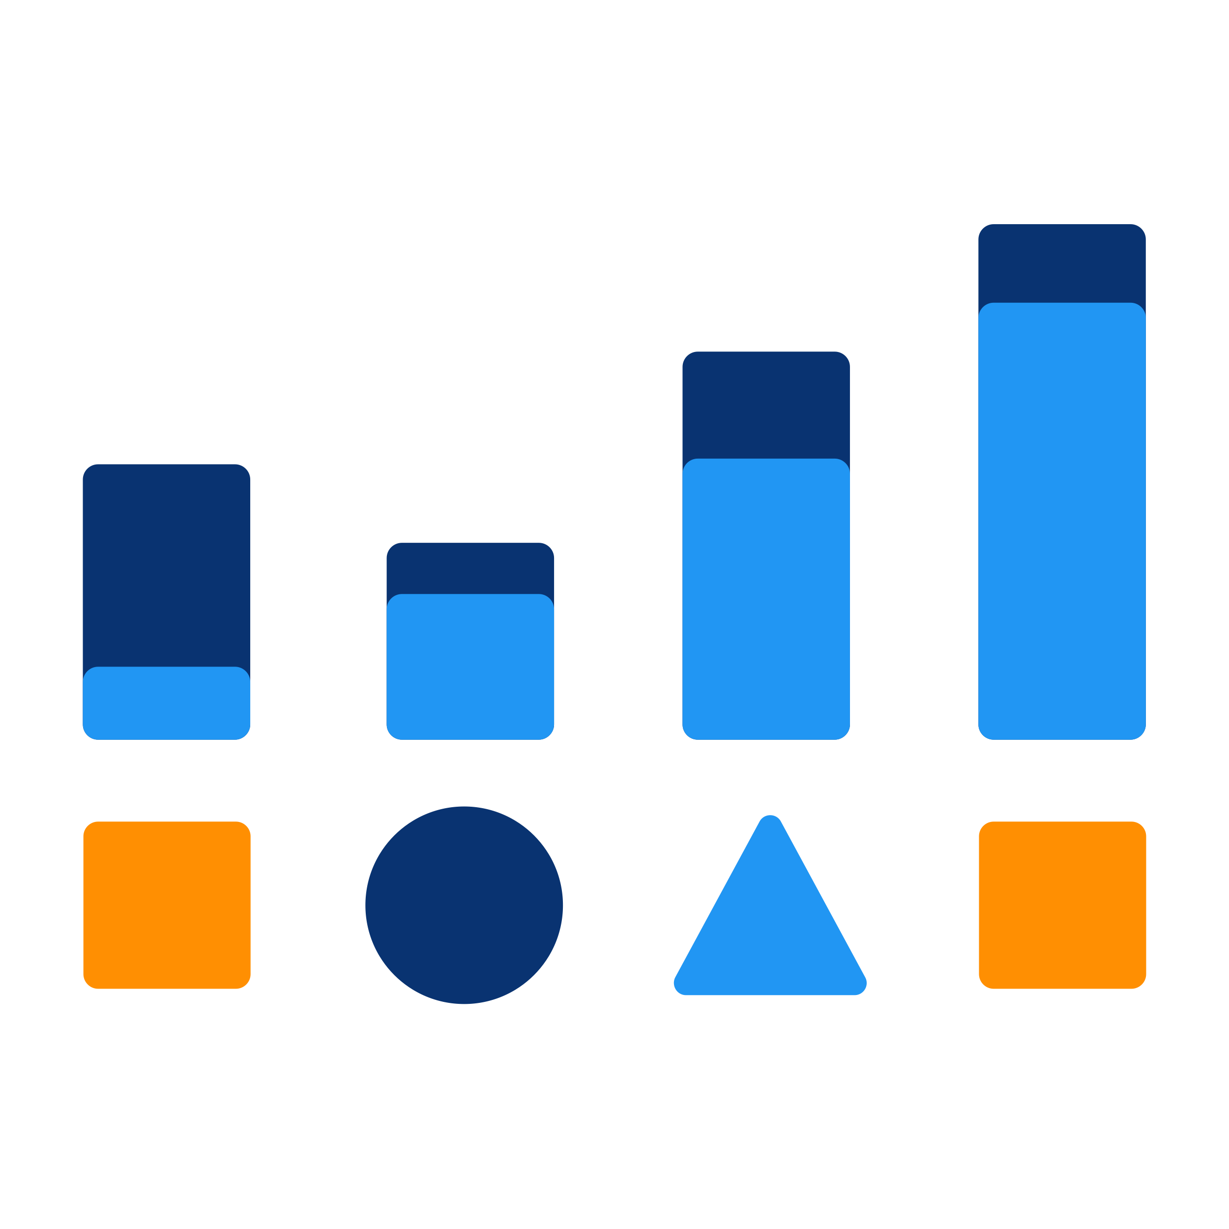


Collection
Validation
Analysis
Presentation
Notes:
In the feature overview section, you learned that DHIS2 is a web-based platform offering tools for collection, data validation, analysis, and presentation of data.

Slide 3

How are data organized within DHIS2?
Notes:
But how are data organized within DHIS2 to enable these capabilities?

Slide 4



3 building blocks
1.
Data elements
2.
Organisation units
3.
Periods
Notes:
In this video, we will take a look at the three building blocks or data dimensions associated with all aggregate data values in DHIS2. They are called "data elements," "organization units," and "periods."

Slide 5

3 building blocks
“What”
Data elements
Metadata
“Where”
Organisation units
Classify
Organize
“When”
Periods
Notes:
These three data dimensions are referred to as metadata in DHIS2 as they provide information we can use to classify and organize the data. "Data Elements" represent “what” is being measured, "Organization units" refers to “where” the data were collected, and “Periods” represent the “when” dimension.

Slide 6







3 building blocks
Data elements
Organisation units
Periods
SMS
API
Notes:
While data are routinely entered using data entry apps, these 3 dimensions are pre-defined. Together, they provide relevant context for the data to be understood.

Slide 7
Example: Adding context to a data value
“What”
“Where”
“When”
39
Notes:
Let's take a look at an example. If there is a data value of 39, this value on its own does not give us enough context. By attaching the “what”, “where” and “when” dimensions to the value, we have a better idea of what it represents.

Slide 8
Example: Adding context to a data value
“What”
Positive malaria cases
Data element
39
“Where”
Namchala Health Centre
Organisation unit
October 2020
“When”
Period
Notes:
Let's suppose that the value 39 represents the number of positive malaria cases. This represents what is being measured, the Data Element or the “what” dimension. These cases were reported in “Namchala Health Centre”. This constitutes the geographical frame, the Organization Unit or the “where” dimension. And lastly, we need to add a time frame, in this case, “October, 2020”, the Period or the when dimension.

Slide 9


Example – 3 building blocks
“What”
“Where”
“When”
39
Notes:
You can see that when we attach these three dimensions to the data value, you can now understand what that value represents: there were 39 cases of malaria in Namchala Health Centre in October 2020.

Slide 10
Metadata
“What”
“Where”
“When”
Data elements
Organisation units
Periods
SMS
API
Notes:
This approach to classifying data separates DHIS2 from many of the traditional health information software. The fact that every data value within DHIS2 consists of these 3 core dimensions independent of any particular source or data collection form means that many different data sources can be integrated into a one single DHIS2 database.

Slide 11
Summary
1.
“What”
Data element
2.
“Where”
Metadata
Context
Classification
Organisation unit
Analysis
3.
“When”
Integration
Period
Notes:
In summary, we learned that each data value in DHIS2 will have at least these three dimensions associated with it: Data Element, the “what,” Organisation unit, the “where” and “Period”, the “when”. Together they are considered “meta-data” because they provide context to data values and enable us to classify and analyze the data as well as enable integration of data from various sources.

